Slide 1
Project Planning, Estimation and Scheduling

Slide 2
Why Do We Measure?
assess the status of an ongoing project
track potential risks
uncover problem areas before they go “critical,”
adjust work flow or tasks,
evaluate the project team’s ability to control quality of software work products.

Slide 3
Metrics
Product Metrics:
Used to measure product characteristics like quality factors, such as reliability, maintainability, defects, and product operational characteristics.
Process Metrics:
Assess the effectiveness of software processes and ensure conformance to standards and guidelines.
Project Metrics:
Used to monitor project plan, track progress, and estimate the project attributes.

Slide 4
Project Metrics
Measure the size, cost, efforts, schedule, and risks.
Projects are generally assessed on the basis of past project experiences and data.
Minimize the project schedule and the required efforts in the project.
It is a fact that product quality can be achieved only if project is delivered on time and within budget.

Slide 5
Project Size Estimation
Size measurement is the initial step for estimating the other attributes of the software.
It is a direct measurement, which is based on the problem size.
Program written in any programming language have some size, whether the program is an assembly code, a high level language code, a GUI code, or a component of a programming language.
There are various units of size measurement such as Lines of Code(LoC), Function Point(FP), Token Count(TC), Object or Class Count(OC) and many more.

Slide 6
Line of Code
A Line of Code metric is based on the measurement of the source lines of the code in a program.
It is simply measured by counting the program header, declarations, executable, and non- executables lines in the source program.
Comments lines, blank lines, and header lines are usually not considered during the LoC measurement.

Slide 7
/*This program finds a substring from a given string */
#include<stdio.h>
#include<conio.h>
#include<string.h>
//Blank line
void main(int argc, char * argv[])
char *temp;
int start, end;
clrscr();
//Blank line
if (argc==4)
{
start = atoi(argv[2]);
end = atoi(argv[3]);
strncpy(temp, argv[1] + start, end);
temp[end]=‘\0’
printf(”entered string : %s\n “, argv[1]”);
printf(“\n substring : %s ”, temp);
}
else
printf(“Incorrect argument”);
getch();
}
LoC=17

Slide 8
LoC is generally counted in kilo(thousand) line of codes (KLoC) per person per month.
Size measurement of the source lines helps to measure the
Defects per KLoC,
errors per KLoC,
Dollars Per KLoC,
Pages of Documentation per KLoC, and so on.
LoC is popularly used estimation technique based on the size of the project.
An accurate estimation is possible after the completion of the project.

Slide 9
Disadvantages of LoC
LoC measurement is very simple but it has some disadvantages.
The value of LoC measurement varies with
the programmer- Every programmer has different technical skills, programming styles, and logical ability
programming language- different programming techniques, source lines may vary
program complexity- some projects are highly complex and need much effort at analysis and design phases
Therefore the LoC value may differ during estimation.
LoC is not suitable for component or reuse based programming technologies where the components are considered as the unit of measurement.

Slide 10
Function Point Analysis
Alan Albrecht proposed another size estimation technique called the function point (FP) analysis.
In the FP analysis, the size of the project is estimated on the basis of functions or services requested by the customer in the requirement specification.
It is a structured technique that decomposes systems down into smaller components so that they can be better understood and analyzed.
It does not deal with the size of the source line of code, which may be underestimated or overestimated by the analyst.
It relies on the product features delivered to the customer.

Slide 11
Advantages over LoC:
FP measurement is programming language independent and programmer independent.
It does not have any constraint specific to the hardware, procedural or non-procedural languages.
An important aspect of FP is the consideration of user’s view through requirement specification or problem description along with developer’s view during requirement decomposition for the FP analysis.

Slide 12
Comparing LOC and FP
Representative values developed by QSM

Slide 13
FP based estimation are based on the following five information domain values and their complexities in a particular project:
Number of inputs
Number of outputs
Number of inquires
Number of internal logical files
Number of external files

Slide 14
Number of inputs: Each user input that provides distinct application oriented data to the software is counted. Inputs should be distinguished from inquiries, which are counted separately.
Number of outputs: Each user output that provides application oriented information to the user is counted. In this context output refers to reports, screens, error messages, etc. Individual data items within a report are not counted separately.
Number of inquiries: An inquiry is defined as an on-line input that results in the generation of some immediate software response in the form of an on-line output. Each distinct inquiry is counted.
Number of internal logical files: Each logical master file (i.e., a logical grouping of data that may be one part of a large database or a separate file) is counted.
Number of external interfaces: All machine readable interfaces (e.g., data files on storage media) that are used to transmit information to another system are counted.

Slide 15
The values of each of these five information domains is collected and a subjective evaluation is performed to categorize them as simple, average, and complex.
There are certain weights assigned at each complexity level to the information domain.

Slide 16
Information Domain and their Weights
Information Domain | Weights
 | Simple | Average | Complex
Number of Inputs | 3 | 4 | 6
Number of Outputs | 4 | 5 | 7
Number of Inquiries | 3 | 4 | 6
Number of External Logical Files | 7 | 10 | 15
Number of External Interfaces | 5 | 7 | 10

Slide 17
Once these data have been collected, a complexity value is associated with each count.
Organizations that use function point methods develop criteria for determining whether a particular entry is simple, average, or complex.
The determination of complexity is subjective.
To compute function points (FP), the following relationship is used:
FP = count total * [0.65 + 0.01 Σ(Fi)]
where count total is the sum of all FP entries obtained from the table.

Slide 18
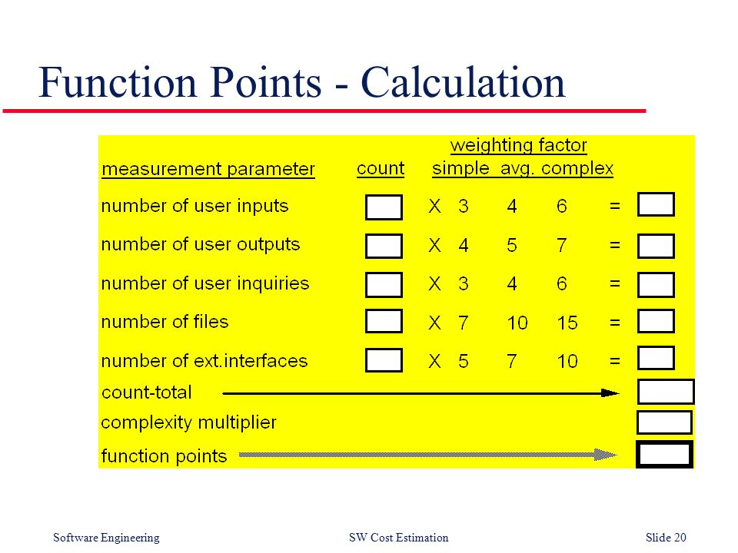

Slide 19
The Fi (i = 1 to 14) are "complexity adjustment values" based on responses to the following questions:
Does the system require reliable backup and recovery?
Are data communications required?
Are there distributed processing functions?
Is performance critical?
Will the system run in an existing, heavily utilized operational environment?
Does the system require on-line data entry?
Does the on-line data entry require the input transaction to be built over multiple screens or operations?
Are the master files updated on-line?
Are the inputs, outputs, files, or inquiries complex?
Is the internal processing complex?
Is the code designed to be reusable?
Are conversion and installation included in the design?
Is the system designed for multiple installations in different organizations?
Is the application designed to facilitate change and ease of use by the user?

Slide 20
Each of these questions is answered using a scale that ranges from
0 (not important or applicable),
1(incidental),
2(moderate),
3(average),
4(significant) and
5 (absolutely essential).
When FPs have been calculated, they are used in a manner analogous to LOC as a way to normalize measures for software productivity, quality, and other attributes:
• Errors per FP.
• Defects per FP.
• $ per FP.
• Pages of documentation per FP.
• FP per person-month.

Slide 21
Problem 1
Compute the FP value for the grade calculation of students. Assume that it is an average complexity size project. The information domain values are as follows: number of inputs = 13, number of outputs = 4, number of inquiries =2, number of files = 5, and number of external interfaces = 2. The total value of complexity adjustment attributes is 13.

Slide 22
Solution 1
Calculation of count total for average complexity size project:
Count Total = Number of Inputs * 4 +
Number of Outputs * 5 +
Number of Inquiries * 4 +
Number of Files * 10 +
Number of Interfaces * 7
= 13 * 4 + 4 * 5 + 2 * 4 + 5 * 10 + 2 * 7 = 144
FP = count total * [0.65 + 0.01 Σ(Fi)]
= 144 * [ 0.65 + 0.01 * 13 ]
= 112

Slide 23
Problem 2
Compute the FP value for vehicle registration at you nearest RTO office. Assume that it is an average complexity size project. The information domain values are as follows: number of inputs = 6, number of outputs = 7, number of inquiries = 5, number of external files = 9, number of interfaces = 4. The total value of complexity adjustment attributes is 9.

Slide 24
Feature Point Metric
Extension of FP that includes the algorithmic complexity of the software
An algorithm is a stepwise procedure with defined rules which are designed to solve a significant computational problem.
Eg: sine routine
Each algorithm is assigned a weight ranging from 1 (elementary) to 10 (sophisticated algorithms)
Feature Point Metric is the weighted sum of algorithms plus the FPs.

Slide 25
Feature Point Metric and FP
FPs are mainly discovered to assess the classical information system, which are different from real-time, process-control, and embedded software applications, which have high algorithmic complexity.
Feature Point measurement is especially useful for systems with a few inputs/outputs and a high algorithmic complexity, such as mathematical software, CAD, AI, Discrete Simulations and military applications.

Slide 26
Object-Oriented Metrics
Number of scenario scripts (use-cases)
Number of support classes (required to implement the system but are not immediately related to the problem domain)
Average number of support classes per key class (analysis class)
Number of subsystems (an aggregation of classes that support a function that is visible to the end-user of a system)

Slide 27
Effort Estimation Techniques
Effort estimation predicts how much time is required to complete a project, how much it costs, and how many engineers are required for completing the project.
These estimation are done before development begins.
Cost estimation can be done in bottom-up or top-down manner.

Slide 28
Types
There are different techniques for effort estimation:
Estimation by Analogy
Delphi Estimation
Algorithmic Cost Modelling
Analytical Techniques

Slide 29
The estimation by analogy is based on the experience of the past projects.
Delphi estimation is based on the group expert judgement to assess the project.
Algorithmic cost model use the size estimation model, which is based upon certain project parameters.
Analytical techniques are based upon assumptions.

Slide 30
Estimation by Analogy
Involves an expert for finding the analogous situations so as to give his opinion
Follows top-down estimation approach
Straightforward technique
Estimation is based on actual project characteristic data
Estimators apply their past experience and the knowledge

Slide 31
Disadvantages-
The estimators have to determine how best they can characterize the projects
Determining similarity: how much confidence can be placed in the analogies and how many projects needs to be compared
It is very difficult to identify what variables should be considered to estimate new projects with known effort values from the analogous projects

Slide 32
Expert Judgement with Delphi
Group Consensus technique
Relies on expert judgement
Follows top-down estimation approach
Coordinators interacts with experts for providing necessary information and documents

Slide 33
Drawbacks:
The team may take pain in collecting the information some information that may not be useful for estimation in the proposed project
It is hard to document the factors used by the experts or expert groups

Slide 34
CoCoMo Algorithmic Cost Model
CoCoMo (Constructive Cost Model) is an algorithmic cost estimation technique proposed by Boehm, which works in a bottom up manner.
It is designed to provide some mathematical equations to estimate the software projects.
These mathematical equations are based on historical data and use project size in the from of KLoC.

Slide 35
The CoCoMo model uses a multivariable size estimation model for effort estimation.
A multivariable model depends on several variables such as development environment, user involvement, memory constraints, techniques used.
A single variable model is based only on the size of the project, Which is given as follows:
Effort = a * Size^{b}
Size is measured in terms of KLoC per Person Month(PM). The constants ‘a’ and ‘b’ are derived from the historical data of the past projects in the organizations.

Slide 36
The value of ‘a’ and ‘b’ in the CoCoMo model vary across the three categories of projects: Organic, Semidetached and Embedded.
Project Category | a | b
Organic | 3.2 | 1.05
Semidetached | 3.0 | 1.12
Embedded | 2.8 | 1.20

Slide 37
Organic projects are very simple and can be developed with a small size team. A simple data processing software is an example of the organic project.
Embedded projects are very complex and have stringent constraints, for example flight control system for aircraft.
Semidetached projects are intermediate in size and complexity. A transaction processing system with fixed requirements for terminal hardware and database software is an example of semidetached category.
CoCoMo estimation is a family of hierarchical models, which includes basic, intermediate, and detailed CoCoMo Model. Each of these models initially estimates the effort based on the total estimated KLoC.

Slide 38
Basic CoCoMo Model
The basic CoCoMo model estimate the effort in a function of the estimated KLoC in the proposed project.
The basic CoCoMo model is very simple, quick, and applicable to small to medium organic type projects.
It is given as follows:
Development Effort (E) = a X (KLoC)^{b}
Development Time = c X (E)^{d}
Where a, b, c and d are constants and these values are derived from the historical data of the past projects.

Slide 39
Project Category | c | d
Organic | 2.5 | 0.38
Semidetached | 2.5 | 0.35
Embedded | 2.5 | 0.32

Slide 40
Example: Assume that a system for simple student registration in a course is planned to be developed and its estimated size is approximately 10,000 lines of code. The organization is proposed to pay 25,000 RS per month to software engineers. Compute the development effort, development time, and total cost for product development.

Slide 41
Solution:
This seems to be an organic project.
Development effort (E) = a X (KLoC) ^{b}
= 3.2 X (10)^{1.05}
= 35.90 Person Month
Development Time(T) = c X (E) ^{d}
= 2.5 X (35.90)^{0.38}
^{= 9.747 months}
Total Product Development Cost = Development time X Salaries of Engineers
= 9.747 X 25,000
= 2,43,675 RS.

Slide 42
Intermediate CoCoMo Model
The basic CoCoMo model determines the effort and time on the basis of project size. There are certain other factors that can affect the project size and hence the development effort and time.
Therefore, Boehm has introduced 15 cost drivers, considering the various aspects of product development environment.
These cost drivers are used to adjust project complexity for estimation of effort and these are termed as Effort Adjustment Factors(EAF). And are classified as computer attributes, product attributes, project attributes, and personal attributes.
The value of each cost attribute is rated by the project manager in the specified project.
These values vary with the project nature and the development environment.

Slide 43
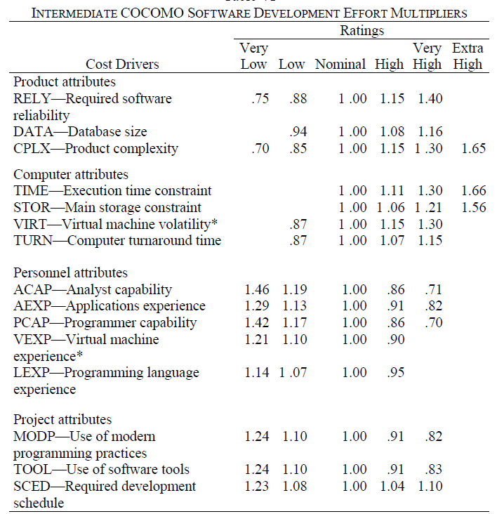

Slide 44
Development Effort:
Initial Effort (E) = a X (KLoC)^{b}
EAF = EAF₁ X EAF₂ X EAF₃……………EAF₁₅
Total Development Effort (E) = E X EAF
Development Time = c X (E)^{d}

Slide 45
Example: Suppose a library management system is to be designed for an academic institution. From the project proposal, the following five major components are identified:
Online Data Enter = 1.0 KLoC
Data Update = 2.0 KLoC
File Input and Output = 1.5 KLoC
Library Reports = 2.0 KLoC
Query and Search = 0.5 KLoC
The database size and application experience are very important in this project. The use of software tool and the main storage is highly considerable. The virtual machine experience and its capability can be kept low. All other cost drivers have minimal requirements. Use the CoCoMo model to estimate the development effort and the development time.

Slide 46
Solution: This seems to be an organic category project. The total size of the project is 7 KLoC.
Development Effort:
Initial Effort = 3.2 X (7)^{1.05}
= 24.6889PM
EAF = 1.16 X 0.82 X 0.91 X 1.06 X 1.10 X 0.87
= 0.8780
Total Effort = E X EAF
= 24.6889 X 0.8780
= 21.6785 PM
Development Time = 2.5 X (E)0.38
= 2.5 X (21.6785)0.38 months
= 8.0469 months

Slide 47
Detailed CoCoMo Model
The detailed CoCoMo model inherits all the features of the intermediate CoCoMo Model for the overall estimation of the project cost.
For detailed planning and scheduling, it is necessary to assess the impact of the cost drivers in phased manner.
The detailed CoCoMo model uses different effort multipliers (cost drivers) for each phase of the project.
Phase wise effort multipliers provide better estimates than the intermediate model.

Slide 48
The detailed CoCoMo model defines the five life cycle phases for effort estimation:
Plan and requirement,
system design,
detailed design,
code and unit test, and
integration and test.
The percentage of effort in a phase varies with the project size and the project nature.

Slide 49
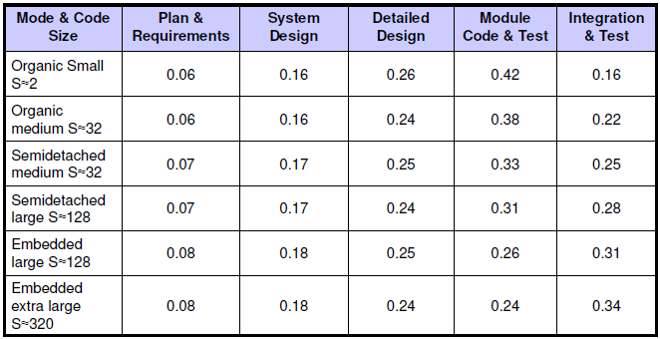
Distribution of the Development Effort

Slide 50
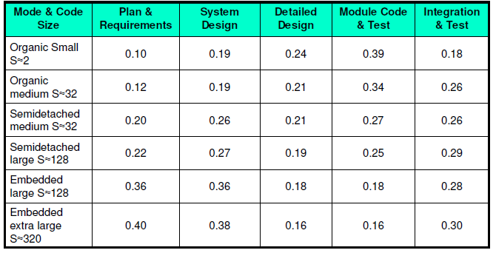
Distribution of the Development Time

Slide 51
Question:
A new project with estimated 400 KLOC embedded system has to be developed. Project manager has a choice of hiring from two pools of developers:
Very highly capable with very little experience in the programming language being used.
Or
Developers of low quality but a lot of experience with the programming language.
What is the impact of hiring all developers from one or the other pool ?

Slide 52
Solution:
This is the case of embedded mode and model is intermediate COCOMO.
Case I:Developers are very highly capable with very little experience in the programming being used.
Initial Effort (E) = a X (KLoC)^{b}
= 2.8 (400)^{1.20}= 3712 PM
EAF = 0.82 x 1.14 = 0.9348
E = 3712 x .9348 = 3470 PM
Development Time = c X (E)^{d}
= 2.5 (3470)^{0.32}= 33.9 M

Slide 53
Case II: Developers are of low quality but lot of experience with the programming language being used.
EAF = 1.29 x 0.95 = 1.22
E = 3712 x 1.22 = 4528 PM
Development Time = 2.5 (4528)^{0.32}= 36.9 M
Case II requires more effort and time. Hence, low quality developers with lot of programming language experience could not match with the performance of very highly capable developers with very little experience.

Slide 54
Question: Consider a project to develop a full screen editor. The major components identified are:
Screen edit
Command Language Interpreter
File Input & Output
Cursor Movement
Screen Movement
The size of these are estimated to be 4k, 2k, 1k, 2k and 3k delivered source code lines. Required software reliability is high, Product complexity is high, Analyst capability is high, Programming language experience is low, All other drivers are nominal. Use COCOMO to determine
1.Overall cost and schedule estimates (assume values for different cost drivers, with at least three of them being different from 1.0).
2.Cost & Schedule estimates for different phases.

Slide 55
Solution
Size of five modules are:
Screen edit= 4 KLOC
Command language interpreter= 2 KLOC
File input and output= 1 KLOC
Cursor movement= 2 KLOC
Screen movement= 3 KLOC
Total= 12 KLOC

Slide 56
(a)The initial effort estimate for the project is obtained from the following equation
EAF = 1.15x1.15x0.86x1.07 = 1.2169
E = a * (KLOC) ^{b} x EAF = 3.2(12)^{1.05} x 1.2169
= 52.91 PM
Development time D = c * (E)^{d} = 2.5(52.91)0.38
= 11.29 M

Slide 57
(b)Using the following equations and referring Table, phase wise cost and schedule estimates can be calculated.
Since size is only 12 KLOC, it is an organic small model. Phase wise effort distribution is given below:
System Design= 0.16 x 52.91 = 8.465 PM
Detailed Design= 0.26 x 52.91 = 13.756 PM
Module Code & Test = 0.42 x 52.91 = 22.222 PM
Integration & Test= 0.16 x 52.91 = 8.465 Pm
Now Phase wise development time duration is-
System Design= 0.19 x 11.29 = 2.145 M
Detailed Design= 0.24 x 11.29 = 2.709 M
Module Code & Test = 0.39 x 11.29 = 4.403 M
Integration & Test= 0.18 x 11.29 = 2.032 M

Slide 58
Example: Compute the phase wise development effort for the previous example.
Solution: The estimated effort is 21.6785 PM. The total size is 7 KLoC, which is between 2 KLoC and 32 KLoC,. Thus, the actual percentage of effort can be calculated as follows.
Plan and requirement (%) = 6 + ( 6 – 6 ) / (32 – 2 ) X 7 = 6%
Effort = 0.06 X 21.6785 PM = 1.30071PM
System Design = 16 + ( 16 – 16 ) / (32 – 2 ) X 7 = 16%
Effort = 0.16 X 21.6785 PM = 3.446856PM
Detailed Design = 24 + ( 26 – 24 ) / ( 32 -2 ) X 7 = 25%
Effort = 0.25 X 21.6785 PM = 5.419625 PM
Code and Unit Test = 38 + ( 42-38 ) / (32 – 2) X 7 = 39%
Effort = 0.39 X 21.6785 PM = 8.454615 PM
Integration and Test = 22 + (16 -22) / (32-2 ) X 7 = 21%
Effort = 0.21 X 21.6785 = 4.552485%

Slide 59
The basic, intermediate, and detailed CoCoMo model are in the categories of CoCoMo I and these are collectively called as CoCoMo 81.
CoCoMo 81 assumed that the product development would proceed in a linear fashion using conventional programming languages.

Slide 60
CoCoMo II
CoCoMo II is an extension of CoCoMo 81.
Since the development of CoCoMo 81, software development techniques have changed.
These changes have changed the development processes from linear to spiral and one-go to incremental way for developing simple to complex projects.
Programming techniques and technologies have moved from conventional to component based software development.
Thus a new and enhanced CoCoMo II model was proposed to overcome the limitation of CoCoMo 81.

Slide 61
CoCoMo II
It consists of some models, each one providing unique features for project planning and design process.
These sub models are-
application composition,
early design,
post architecture, and
reuse models.

Slide 62
Application Composition Model
Best suitable for prototyping projects and projects where there is extensive reuse of components
It involve prototyping efforts to resolve unexpected risks related to GUI, device interaction, performance, technology maturity
Estimation is based on standard estimates of the developer productivity in object points/months and the use of CASE tools
An object point defines the artifacts, such as the number of screens, reports and 3GL modules/components in the application

Slide 63
The effort estimation in an application is computed as follows:
Effort (E) = (∑AP * (1 - %reuse/100) ) / PROD
Where,
∑AP is the sum of application points
PROD is the productivity of programmers from the historical data rated on some scale as:
very low=4, nominal=13, high=25, and very high=50
%reuse is the percentage of reusable components

Slide 64
Early Design Model
Used once requirements have been stabilized and basic software architecture has been established.
Estimation formula used as given:
Effort (E) = A * (Size)^{B} * EAF
Where,
A = Constant representing the nominal productivity, provisionally set to 2.5
B = Scale factor, value varies from 1.1 to 1.24, depending on project complexity, process maturity level, development flexibility, risk resolution process, and cohesion of development team in organization
Size = Software size in KLOC
EAF = Effort Adjustment Factor (Cost Drivers)

Slide 65
There are seven early design cost drivers and are given below:
Product Reliability and Complexity (RCPX)
Required Reuse (RUSE)
Platform Difficulty (PDIF)
Personnel Capability (PERS)
Personnel Experience (PREX)
Facilities (FCIL)
Schedule (SCED)

Slide 66
Post-Architecture Model
Used during the construction of the software
Used once the system architecture has been designed and sufficient information is available for the development and maintenance of the system
At this stage, requirements have been refined and validated, operational features have been finalized, most of the risks have been resolved, and a framework for the product has been designed
Estimation formula used as given:
Effort (E) = A * (Size)^{B} * EAF
KLOC or FP can be used for determining the project size

Slide 67
There are 17 cost drivers in the Post Architecture model. These are rated on a scale of 1 to 6 as given below:
Reliability Required (RELY)
Database Size (DATA)
Product Complexity (CPLX)
Required Reusability (RUSE)
Documentation (DOCU)
Execution Time Constraint (TIME)
Main Storage Constraint (STOR)
Platform Volatility (PVOL)
Analyst Capability (ACAP)
Programmers Capability (PCAP)
Personnel Continuity (PCON)
Analyst Experience (AEXP)
Programmer Experience (PEXP)
Language & Tool Experience (LTEX)
Use of Software Tools (TOOL)
Site Locations & Communication Technology between Sites (SITE)
Schedule (SCED)

Slide 68
Empirical Estimation Models
Among the many LOC-oriented estimation models proposed in the literature are-
E = 5.2 x (KLOC)^{0.91} Walston-Felix model
E = 5.5 + 0.73 x (KLOC)^{1.16} Bailey-Basili model
E = 3.2 x (KLOC)^{1.05} Boehm simple model
E = 5.288 x (KLOC)^{1.047} Doty model for KLOC > 9
FP-oriented models have also been proposed. These include
E = -13.39 + 0.0545 FP Albrecht and Gaffney model
E = 60.62 x 7.728 x 10⁻⁸ FP³ Kemerer model
E = 585.7 + 15.12 FP Matson,Barnett,& Mellichamp model
A quick examination of these models indicates that each will yield a different result14 for the same values of LOC or FP. The implication is clear. Estimation models must be calibrated for local needs!

Slide 69
Work Breakdown Structure (WBS)
WBS breaks down project into major components (modules).
Modules are further broken down into subcomponents, components, activities, and finally, into individual tasks.
Identifies activities, tasks, resource requirements and relationships between modules and activities.
Helps avoid duplication of effort.
Basis for project development, management , schedule resources and modifications.
Approaches for WBS development:
1. Top down process 2. Brainstorm entire project

Slide 70
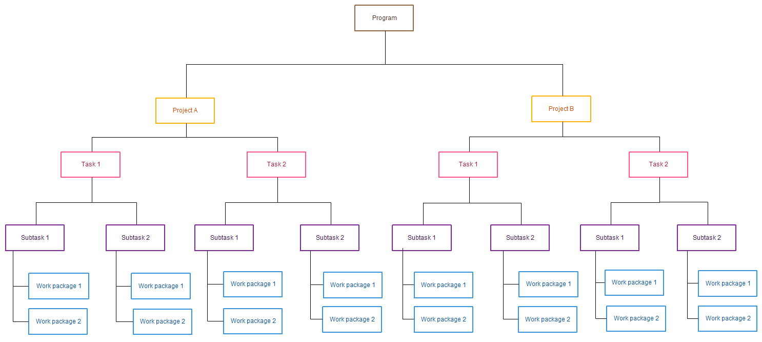
Work Breakdown Structure

Slide 71
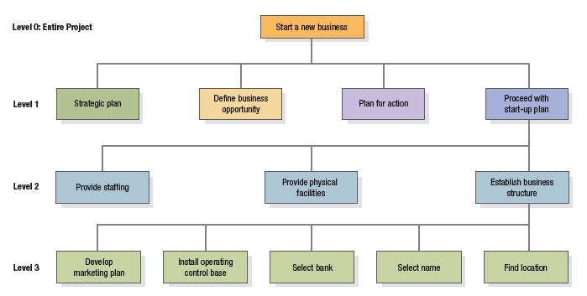
A Work Breakdown Structure (three levels) for a new business

Slide 72
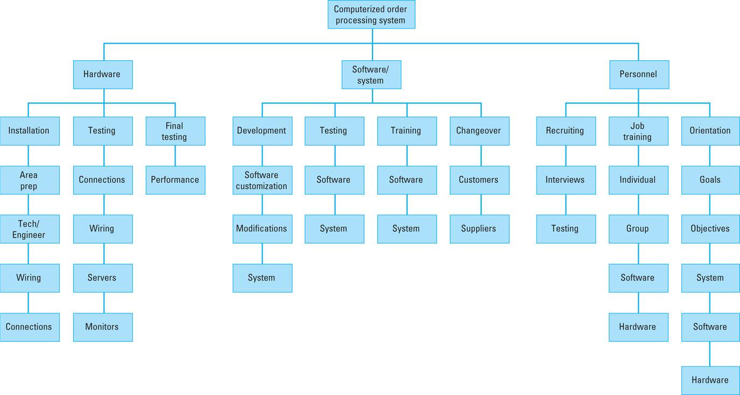
Work Breakdown Structure
WBS for computerized order-processing system project

Slide 73
Project Scheduling
Project schedule evolves from planning documents, with focus on timely completion.
Critical element in project management – source of most conflicts and problems.
Schedule development steps:
1. Define activities, 2. Sequence activities,
3. Estimate activity times, 4. Develop schedule.
Gantt chart and CPM/PERT techniques can be useful.

Slide 74
PERT Charts
PERT = Project Evaluation and Review Technique
PERT chart = graphical representation of the scheduling of events in a project
Sample PERT Chart:
A PERT chart is a graph
Edges are tasks/activities that need to be done
Nodes are the events or milestones
Task edge T from event node E1 to event node E2 signifies:
Until event E1 happens, task T cannot be started
Until task T finishes, event E2 cannot happen
Events often simply represent completion of tasks associated with arrows entering it
6
3
10
E
B
3
13
0
4
2
6
A
13
1
4
2
F
0
4
C
7
D
10
3
3
4
3
5
7
10

Slide 75
PERT Chart Task Edges
Parts of a task/activity edge
Task letter:
Often keyed to a legend to tell which task it represents
Task duration = how long (e.g. days, hours) task will take
Task letter
D
5
Task duration

Slide 76
PERT Chart Event Nodes
Event Number:
Sequence number assigned
Only task edges indicate dependencies
Earliest Completion Time (ECT):
Earliest time this event can be achieved, given durations and dependencies
9
5
19
Latest Completion Time (LCT):
Latest time that this event could be safely achieved

Slide 77
Building a PERT Chart
Steps:
Make a list of all project tasks (and events if possible).
Find interrelated task dependencies (what task has to be completed before other tasks)
Draw initial PERT without durations, ECTs or LCTs
Estimate duration of each task
Fill in durations
Calculate ECTs and LCTs
We will do this for an example system:
→ Generic software system with 3 modules

Slide 78
Example: Generic Software Project
TASK ID Task Description
A Specification
B High Level Design
C Detailed Design
D Code/Test Main module
E Code/Test DB module
F Code/Test UI module
G Write test plan
H Integrate/System Test
I Write User Manual
J Typeset User Manual
To start PERT chart: identify dependencies between tasks

Slide 79
Dummy Tasks
Sometimes it is necessary to use dummy tasks:
Shows the dependency between 2 events where no activity is performed
Example:
Events 3, 4 signify the compilation of separate modules.
Create an event 5 to signify “all modules compiled together”.
Denote dummy tasks using dash lines
9
3
10
T
9
5
12
3
9
4
12

Slide 80
Example: Tasks with Dependencies
To start the PERT, identify the dependencies amongst tasks
TASK ID Task Description Preceed ID Succ. ID
A Specification 1 2
B High Level Design 2 3
C Detailed Design 3 4
D Code/Test Main 4 5
E Code/Test DB 4 6
F Code/Test UI 4 7
G Write test plan 4 8
Dummy Task 5 8
Dummy Task 6 8
Dummy Task 7 8
H Integrate/System Test 8 9
I Write User Manual 8 10
J Typeset User Manual 10 9

Slide 81
Software Example: Skeleton PERT Chart
5
D
A
B
C
E
H
1
2
3
4
6
8
9
I
F
J
7
1
G
Note: dummy tasks connecting events 5, 6 and 7 to 8

Slide 82
Estimating Durations
Suggestions for estimating durations of tasks:
Don’t just make up a number
Look at previous similar tasks from other projects and use those as guidelines
Try to identify factors such as difficulty, skill level
Each weighting factor will help you make a better estimate
Factors to consider:
Difficulty of task
Size of team
Experience of team
Number, attitude and availability of end users
Management commitment
Other projects in progress

Slide 83
PERT Chart With Durations
5
D
7
A
B
C
E
H
1
2
3
4
6
8
5
9
3
2
2
6
F
I
J
2
1
3
7
1
G
2
Say we have estimated durations of all tasks (in days)
New PERT chart, with durations filled in:
Note, dummy tasks (dashed lines) always have a duration of zero
Notes:
Dummy tasks always have 0 duration.
From this, we can calculate ECTs and LCTs

Slide 84
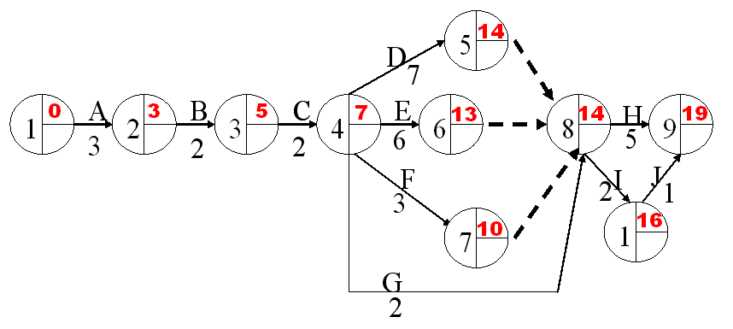
Calculating ECTs
ECT = earliest time event can be completed
To calculate:
For an event not depending on others: ECT = 0
Usually this is the first event
For an event E depending on one or more others:
Calculate ECTs of event(s) that E depends on
Add duration(s) of task(s) leading to E
If E depends on more than one event, take MAX
Proceed left to right ( → ) through the chart
Exercise: calculate the ECT for our example.

Slide 85
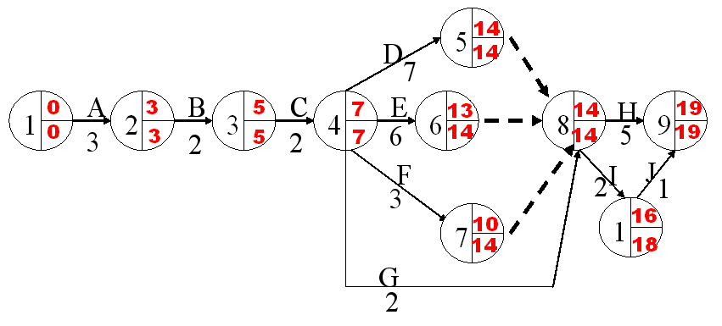
Calculating LCT
LCT = latest time event can be completed, while still finishing last ask at indicated time
To calculate:
For an event which no other events depend on: LCT = ECT
Generally there will only be one such event
For an event E which one or more others depend on:
Calculate LCTs of event(s) that depend on E
Subtract duration(s) of task(s) leading from E
If more than one event depends on E, take MINIMUM
Proceed right to left ( ← ) through PERT chart
Exercise: calculate LCT for our example

Slide 86
Critical Path
Red line is the critical path
What does it represent?

Slide 87
Uses of PERT Charts
We can use PERT charts for:
Determining the estimated time to complete a project
Deriving actual project dates
Allocating resources
Identifying potential and current problems (is one task behind schedule?, can we shuffle people?)
Critical Path: Path through chart such that if any deadline slips, the final deadline slips (where all events have ECT = LCT (usually there is only one)
In software example:
Task I is not on the critical path: even if we don’t finish it until time 18, we’re still okay
Task D is on the critical path: if we don’t finish it until for example, time 16, then:
We can’t start task H (duration 3) until time 16
So we can’t complete task H until time 21
We can use PERT charts for
Identifying the critical path
Reallocating resources, e.g. from non-critical to critical tasks.

Slide 88
Gantt Chart
Visual scheduling tool
Graphical representation of information
Show dependencies between tasks, personnel, and other resources allocations
Track progress towards completion

Slide 89
Building a Gantt Chart
List all tasks and milestones from the project along the vertical axis
List time frame along the horizontal axis
Activity 1
Activity 2
Milestone
Time Frame: day 1 day 2 day3

Slide 90
Building a Gantt Chart
Activities: Create box the length of each activity time duration
E.g., activity one is scheduled from day1-day3
Activity 1
Activity 2
Time Frame: day 1 day 2 day3

Slide 91
Building a Gantt Chart
Dependencies: Show dependencies between activities with arrows
E.g., activity 2 cannot start until activity 1 is complete
Activity 1
Activity 2
Time Frame: day 1 day 2 day3…

Slide 92
Example Gantt Chart
TASKS
A Study current email system
B Define end-user requirements
C Design Class diagram
D Acquire computer technology
E Plan & code email modules
F Acceptance test new system
G Deliver new system
1 2 3 4 5 6 7 8 9 10 11 12
Today
Questions: From the above, can you guess:
Which, if any, tasks should have been completed by today and aren’t even started? ______
Which, if any, tasks have been completed? ______
Which, if any, tasks have been completed ahead of schedule:? ______
Which, if any, tasks are on or ahead of schedule? _________
Which, if any, tasks are behind schedule? ________

Slide 93
Sequence of Activities of The Project - House Building
Number | Activity | Predecessor | Duration
1 | Design house and obtain financing | -- | 3 months
2 | Lay foundation | 1 | 2 months
3 | Order and receive materials | 1 | 1 month
4 | Build house | 2,3 | 3 months
5 | Select paint | 2, 3 | 1 month
6 | Select carper | 5 | 1 month
7 | Finish work | 4, 6 | 1 month

Slide 94
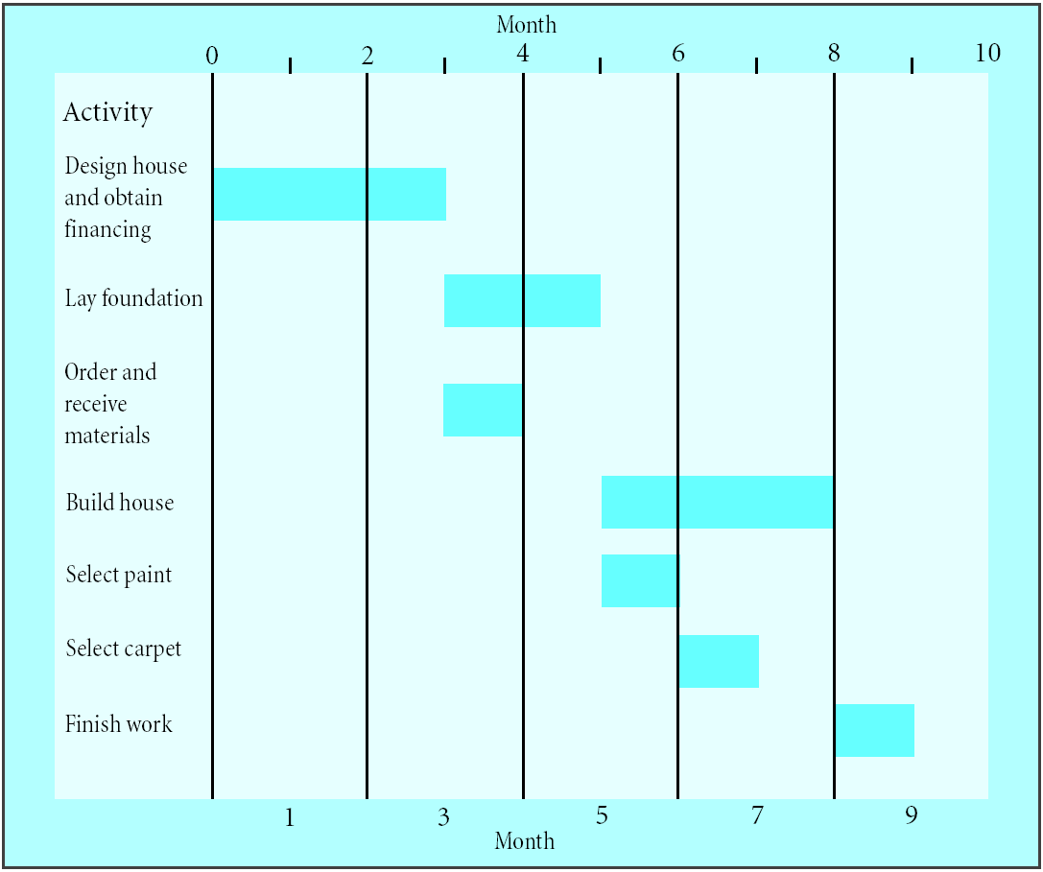
Gantt Chart for House Building Project
A Gantt chart

Slide 95
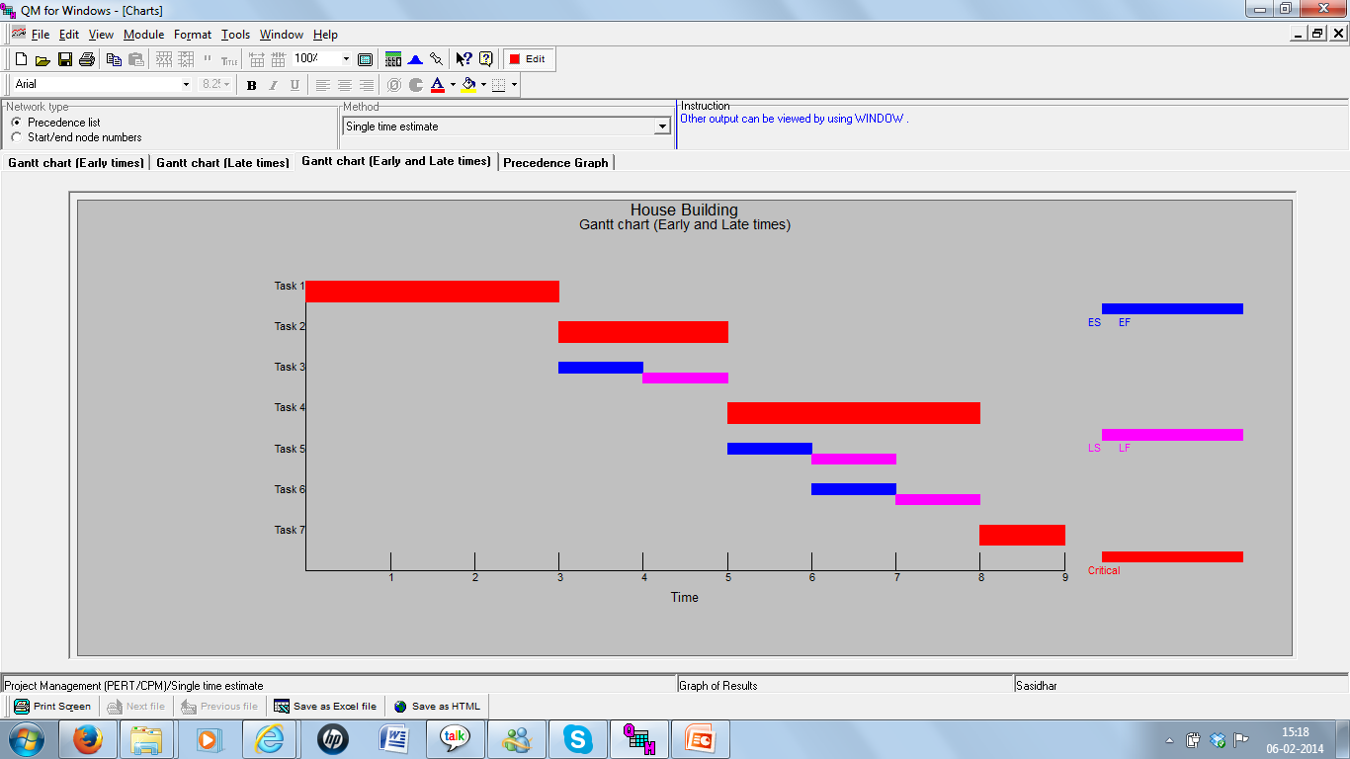
Gantt Chart for House Building Project using QM for Windows

Slide 96
Gantt Charts
Establish a time-phased network
Can be used as a tracking tool
Benefits of Gantt charts
Easy to create and comprehend
Identify the schedule baseline network
Allow for updating and control
Identify resource needs

Slide 97
PERT vs. Gantt
PERT chart
All us to show dependencies explicitly
Allow us to calculate critical path
Can tell us how one task falling behind affects other tasks
Gantt charts
Allow us to record progress of project
Allow us to see what tasks are falling behind
Allow us to represent overlapping tasks

Slide 98
Timeline Charts
Tasks
Week 1
Week 2
Week 3
Week 4
Week n
Task 1
Task 2
Task 3
Task 4
Task 5
Task 6
Task 7
Task 8
Task 9
Task 10
Task 11
Task 12

Slide 99
Use Automated Tools to Derive a Timeline Chart

